Slide 1
PROJECT :
ONLINE HOTEL MANAGEMENT SYSTEM
Created by :
Arghya Nayak
Abhijit Mandal
Hriya Ghosh
Pervez Mosaraf Sk
Raktim Das
Shritama Ghosh
SK Nisar Mehetaz Khan
Sujit Kumar Parida

Slide 2
INTRODUCTION
In this project , we have tried our best to make the complicated process of Online Hotel Management System as simple as possible using Structured & Modular technique & Menu oriented interface.
IDEA:
We have tried to design the software in such a way that user may not have any difficulty in using this package & further expansion is possible without much effort.
The main purpose of this project is to perform each activity for booking a hotel in computerized way rather than maally which is time consuming.
FEATURES :
This is a user friendly online hotel booking system.
To register in this system ,users are need to provide only their personal details.
Users can login in to this system , check available hotels in their favorite place and book their preferable one using this system.

Slide 3
PROJECT TOOLS
1.XAMPP SOFTWARE :
XAMPP is a free and open-source cross-platform web server solution stack
package developed by Apache Friends, consisting mainly of the Apache HTTP
Server, MariaDB database, and interpreters for scripts written in the PHP and
Perl programming languages.
2. VISUAL STUDIO CODE :
Visual Studio Code is a source-code editor developed by Microsoft for Windows,
Linux and macOS.
It includes embedded Git and support for debugging, syntax highlighting,
intelligent code completion, snippets and code refactoring.
3. INTERNET EXPLORER :
Graphical web browsers developed by Microsoft and included in the Microsoft
Windows line of operating systems.

Slide 4
CODING LANGUAGES
USED
Continue.
HTML :
Hypertext Markup Language is the standard markup language for documents designed to be displayed in a web browser.
CSS :
Cascading Style Sheets is a style sheet language used for describing the presentation of a document written in a markup language like HTML.
JAVASCRIPT :
JavaScript (JS) is a lightweight, interpreted, or just-in-time compiled programming language with first-class functions. While it is most well known as the scripting language for Web pages.

Slide 5
PHP :
PHP is a widely used server-side programming language that’s become increasingly fast and powerful over the years. PHP works well with HTML and databases, making it a great language for anyone interested in building dynamic web applications.
SQL :
SQL is a standard language for storing, manipulating and retrieving data in databases.

Slide 6

FRONT PAGE
Welcome to our Hotel Management Website !

Slide 7
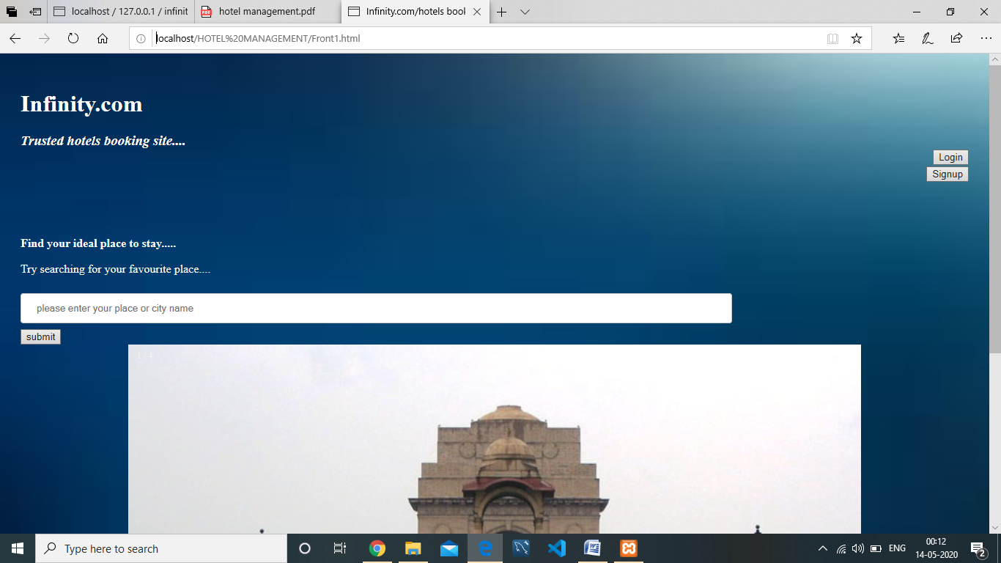

Slide 8
SIGNUP PAGE
If you are a new user and want to register our hotel management system :
Head over the Signup Button and the signup page will appear .
You need to provide your details like :
Full Name
Email I’d
Contact details
Password

Slide 9
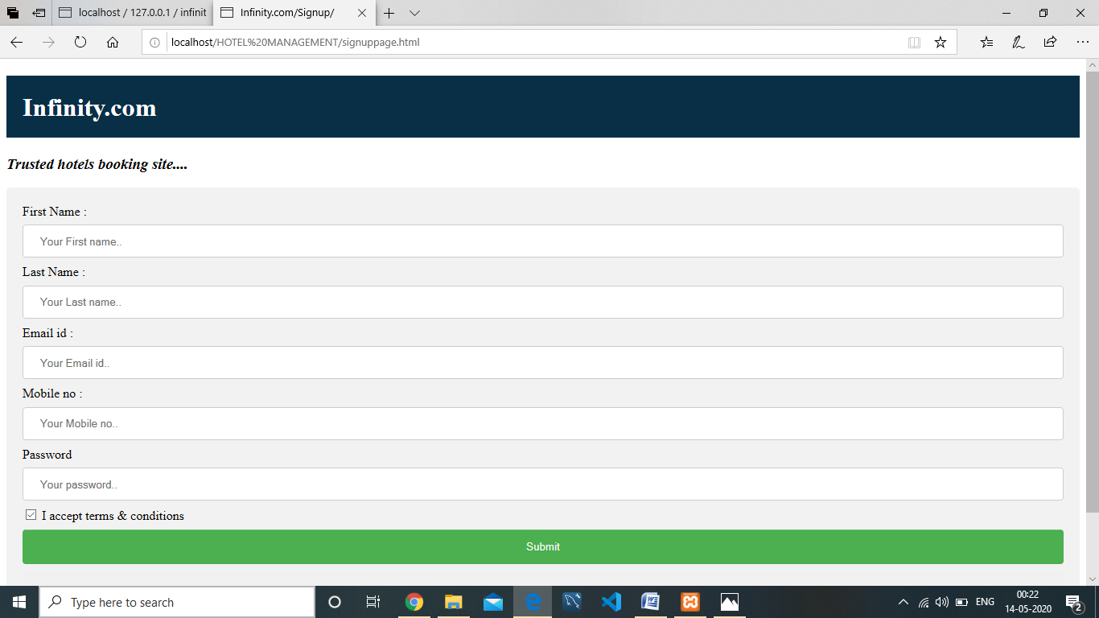

Slide 10
LOGIN PAGE
If you are already registered then :
Click on Login button and provide your email id and password.

Slide 11
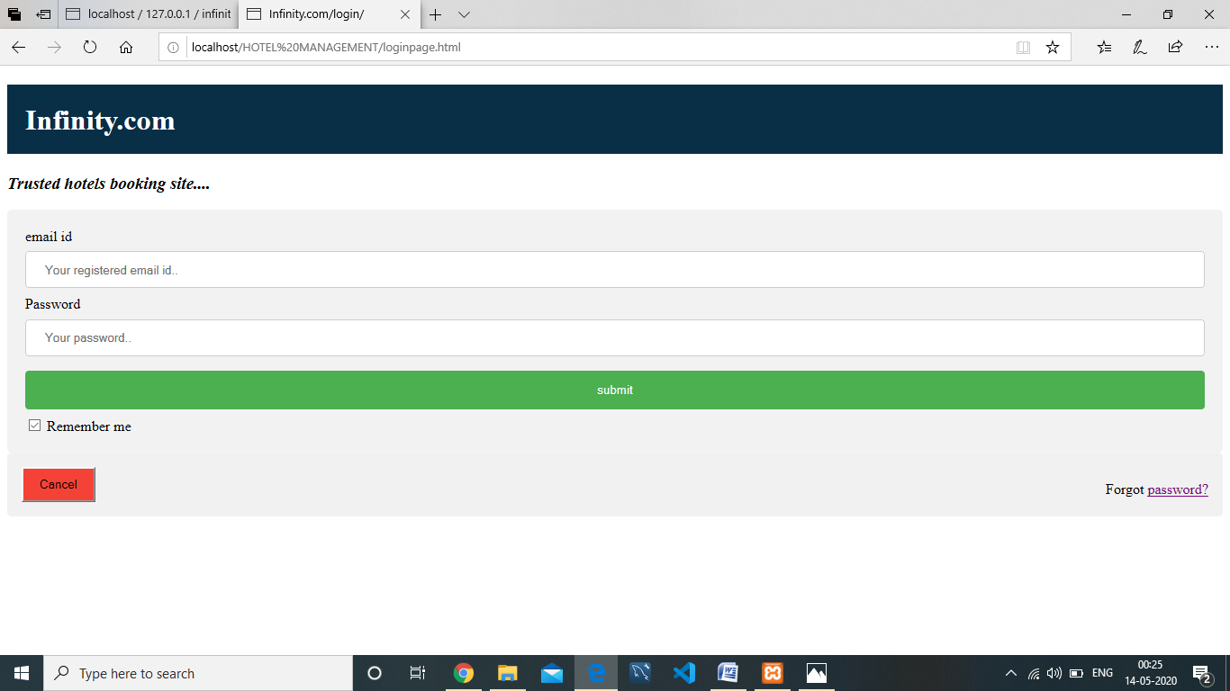

Slide 12
HOTEL SEARCH PAGE
Dive into the ocean of hotels where you can find your preferable hotel in just a click!

Slide 13
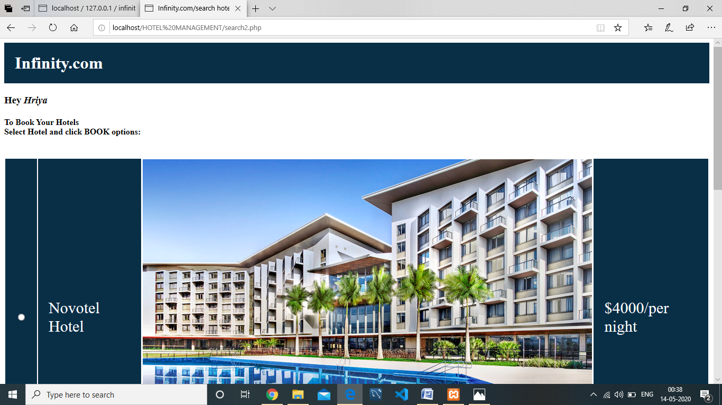

Slide 14
BOOKING PAGE
If you have found your desired hotel then what are you waiting for!
Book it now..
Here user need to enter
Check in details,
Check out details

Slide 15
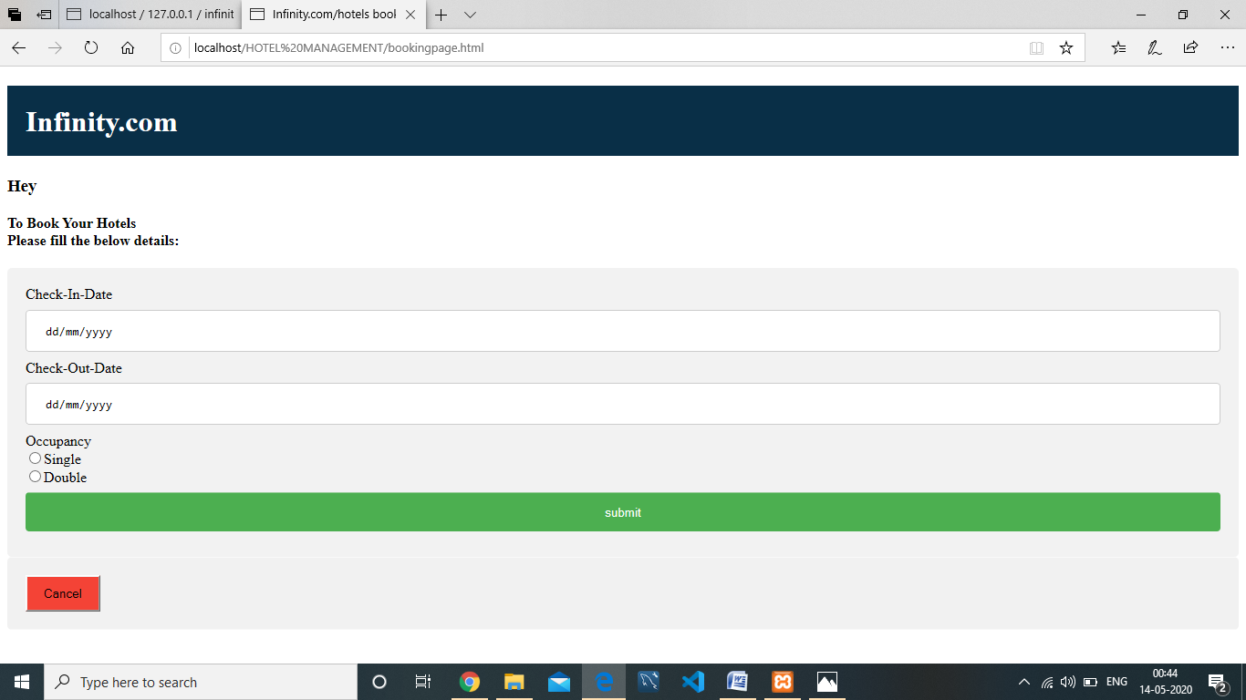

Slide 16
BOOKING HISTORY
If you want to see the booking histories then mouse over the Booking history button.

Slide 17
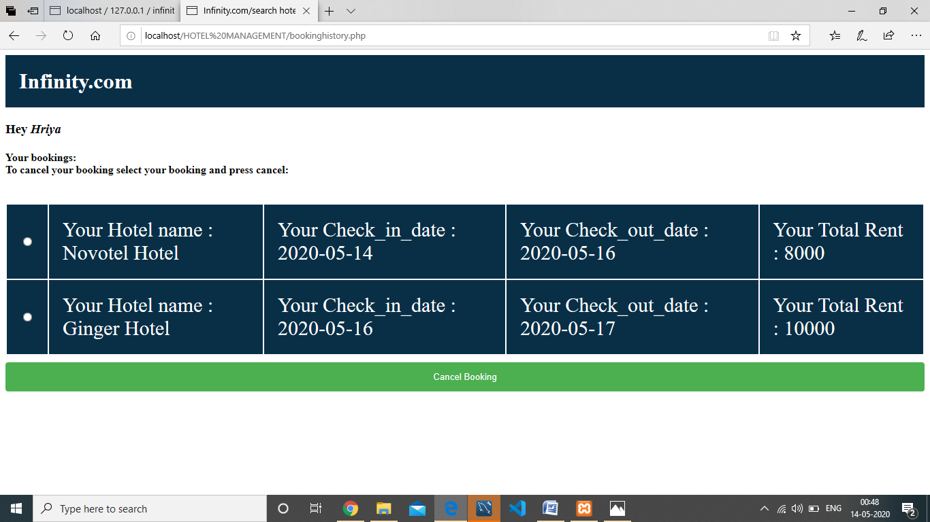

Slide 18

Thank you! Visit again to our Hotel Management Website.

